Slide 1
Abstract
Problem Statement:
Obesity is a condition with major health implications across all segments of the population. Early adulthood is a period when people are particularly vulnerable to weight gain. Further, over 70 percent of college aged students do not eat the recommended 5 servings of fruits and vegetables.
Approach:
In order to address this health problem, people must be taught to recognize the problem and to self motivate to change given the necessary tools according to Bandura’s social cognitive theory. Additionally, focus groups utilized by a previous study found that three barriers to healthy eating in this population are peer influence, cost, and time availability. College-aged students are an easily targeted and impressionable population with potential to influence their peers exponentially. Our aim is to affect obesity by increasing fruit and vegetable intake among this population and to encourage the adoption of overall healthier eating habits using the PRECEDE-PROCEED model as our framework.
Intervention
We will use student dining accounts to track food purchases and provide feedback about fruit and vegetable intake to students via an app on their mobile phones and social media. Modifications to the student food and social environment would include prominent placement of healthy foods, providing pre-portioned meals, pricing healthier foods so that they are more affordable than unhealthy alternatives, and displaying educational posters on tables, meal trays, and in the cafeteria. Healthy behavior such as eating the recommended daily intake will be encouraged.
Lessons Learned
Students have the desire to adopt healthier eating habits. Their college environments are suboptimal, however, in terms of providing the tools they need to do so.
*

Slide 2
Problem Statement
Background
US college students have been known colloquially and via research studies to gain significant weight during their freshman year—at an average of 1.8 kg over 9 months by some estimates (Nikolaou, 2014).
As Drewnowski et al discovered, there is a connection between obesity and high density, low cost foods, such as those from “refined grains, added sugars, and added fats” (2005).
It is important to address poor food choices such as inadequate fruit and vegetable intake among first year college students because this can lead to weight gain in early adulthood.
Health behavior
College students have an average intake of 2 ½ cups of fruits and vegetables a day, which for men is half the recommended intake.
Impact
It is necessary to address the obesity problem at this stage because young adults tend to gain weight at a much faster rate than older adults (Nikolaou, 2014).
By making students aware of their habits and available options, we can affect their basis for decision-making and thereby decrease the rate of obesity in this population.
Nikolaou, C. K., Hankey, C. R., and Lean, M. E. (2014). Weight changes in young adults: a mixed methods study. International Journal of Obesity, [Epub ahead of print], doi: 10.1038/ijo.2014.160
Drewnowski, A., & Darmon, N. (2005). The economics of obesity: Dietary energy density and energy cost 1,2,3,4. American Journal of Clinical Nutrition, 82(1), 2655-- 2735.
*

Slide 3
Intended Audience
The intended audience is Baltimore college students living in campus dormitories.
College students who eat at pay-per-item style dining halls and campus convenience stores so we can track their purchases.
We excluded current dieters and student athletes because although these groups may benefit, our messages are not targeted toward their specific needs.
The pertinent characteristics of the audience are young adults, ages 18-22, who value convenience and low cost food options, and do not have the time, space or equipment to cook meals for themselves.
Morgan, A.Z., et al. (2012). Eating Regulation Styles, Appearance Schemas, and Body Satisfaction Predict Changes in Body Fat for Emerging Adults. J Youth Adolescence, 41:1127–1141.
*

Slide 4
Approach: Data
US college students gain an average of 1.8kg over 9 months during their freshman year.
Female college students who do not feel in control of their physical appearance are at a higher risk for weight gain, while students of either gender with high autonomous regulation and high motivational salience showed a protective effect.
Students have an average intake of 2½ cups of fruit and vegetables a day against the recommended 5 cups a day for men and 4½ cups for women.
College students reported in focus groups and surveys that time management, budgeting, and peer influence are the major barriers to fruit and vegetable intake.
Morgan, A.Z., et al. (2012). Eating Regulation Styles, Appearance Schemas, and Body Satisfaction Predict Changes in Body Fat for Emerging Adults. J Youth Adolescence, 41:1127–1141.
Nikolaou, C. K., Hankey, C. R., and Lean, M. E. (2014). Weight changes in young adults: a mixed methods study. International Journal of Obesity, [Epub ahead of print], doi: 10.1038/ijo.2014.160
Walsh, J., White, A.A., Byrd-Bredbenner, C., Colby, S., Esters, O., Greene, G., Hoerr, S., Horacek, T., Kattelmann, K., Kidd, T., Nitzke, S., Phillips, B. (2010). Use of a Multi-Phase Community Assessment Model to Identify Behavioral and Environmental Influences of Obesity for Young Adults. Journal of the American Dietetic Association,110(9), A19.
*

Slide 5
Approach: Social Cognitive Theory & Needs Assessment
Bandura, A. (1991). Social cognitive theory of self-regulation. Organizational Behavior and Human Decision Processes, 50, 248-287.
Aspect of Social Cognitive Theory | Findings of Needs Assessment | Theory
Cognitive Factors | College students want to have healthier eating habits (eat fruits and vegetables) and think it’s important. | Knowledge and attitudes about importance of fruit and vegetable intake.
Environmental Factors | Class schedule, layout of dining halls and convenience stores, and peer influence all play a role in food choices. | Use social media campaign to influence social norms; increase access and visibility of fruits & vegetables in the environment.
Behavioral Factors | Students do not manage time between classes to eat; do not have experience or ability to manage their finances. | Use mastery experiences to build self-efficacy around budgeting and time management.

Slide 6
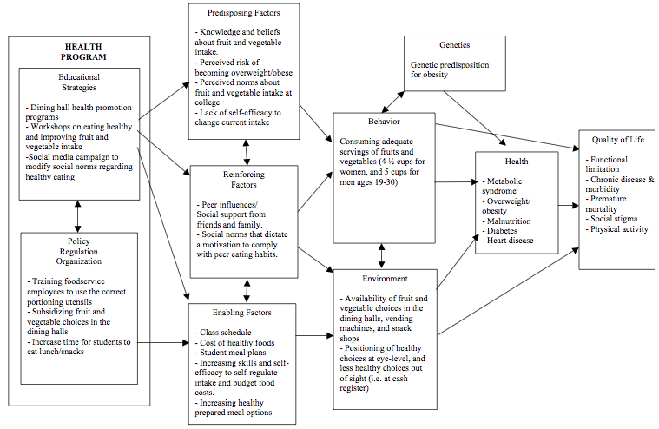
PRECEDE/PROCEED Framework
6

Slide 7
Intervention
Predisposing Factors:
Environmental & cognitive factors
Educational booths, stations or posters at the dining hall.
  Students reported that dining halls would be a good source of intervention
Advertising nutrition information.
Featuring healthy meal options (prepared food).
Changing products at cashier from chips or cookies to fruit and granola bars.
  The program we conduct must create a physical environment that supports and facilitates the consumption of fruits and vegetables, and students believe they have the resources and social support to change their eating habits.
Bandura, A. (1991). Social cognitive theory of self-regulation. Organizational Behavior and Human Decision Processes, 50, 248-287.
Strong, K. A., Parks, S. L., Anderson, E., Winett, R., & Davy, B. M. (2008). Weight gain prevention: Identifying theory-based targets for health behavior change in young adults. Journal of the American Dietetic Association,108(10), 1708-1715.e3. doi:http://dx.doi.org/10.1016/j.jada.2008.07.007
*

Slide 8
Intervention - continued
Reinforcing Factors:
Incentive Motivation, Self-monitoring, Enlistment of support and Observational learning
Feedback: Track fruit and vegetable intake through app.
Social media campaign through instagram and Facebook #HealthyHopkins.
  To create an environment that supports the behavior we aim to change in order to facilitate and enforce this behavior.
  Students addressed peer influence as barriers to increasing fruit and vegetable intake (Self-efficacy).
  The social norms of a college campus lack positive feedback for healthy behaviors.
  By seeing others reap the physical and emotional benefits of healthier eating (quality of life), students can begin to understand what outcomes to expect.
  Providing social incentives.
Bandura, A. (1991). Social cognitive theory of self-regulation. Organizational Behavior and Human Decision Processes, 50, 248-287.
Bandura, A. (1997). Self-Efficacy: The Exercise of Control: Worth Publishers.
Nikolaou, C. K., Hankey, C. R., and Lean, M. E. (2014). Weight changes in young adults: a mixed methods study. International Journal of Obesity, [Epub ahead of print], doi: 10.1038/ijo.2014.160
McAllister, A., Perry, C., Parcel, G. (2008). How individuals, Environments, and Health Behaviors Interact. Health Behavior and Health Education: Theory, Research and Practice (4th Ed) K. Glanz, B. Rimer, K. Viswanath (Eds.). San Francisco, CA: Wiley Imprint.
*
*

Slide 9
Intervention - continued
Enabling Factors:
Cognitive: increases self-efficacy
Workshops on healthy eating, teaching skills of time management and budgeting.
  Time management and budgeting found to be major factors preventing the students from eating fruits and vegetables.
Environmental & cognitive factors
Change the offerings/ product placement at convenience stores on campus & in cafés
  Placing healthy choices at eye level.
  Offer water at slightly discounted prices than soda and other sugary beverages.
The incentive motivation in the environment requires increasing both availability and accessibility of fruit and vegetables by both increasing supply and lowering prices.
Policy regulation
Enforcing portion control & Smaller cups for soda fountain.
  Buffet-style meal plans reported to be a barrier to healthy eating and self-regulation.
Changing class scheduling to allow more time for students to eat.
Students reported tight class scheduling as an obstacle to eat fruits and vegetables.
Bandura, A. (1991). Social cognitive theory of self-regulation. Organizational Behavior and Human Decision Processes, 50, 248-287.
Bandura, A. (1997). Self-Efficacy: The Exercise of Control: Worth Publishers.
Nikolaou, C. K., Hankey, C. R., and Lean, M. E. (2014). Weight changes in young adults: a mixed methods study. International Journal of Obesity, [Epub ahead of print], doi: 10.1038/ijo.2014.160
LaCaille, L. J., Dauner, K. N., Krambeer, R. J., & Pedersen, J. (2011). Psychosocial and environmental determinants of eating behaviors, physical activity, and weight change among college students: A qualitative analysis.Journal of American College Health, 59(6), 531-538. doi:10.1080/07448481.2010.523855
*
*

Slide 10
Conclusion
Needs Assessment
Our needs assessment was done by using focus group results from a study conducted by Nikolaou et al involving over 1200 college freshmen. The study also found that less than 30 percent of the students ate the recommended 5 servings of fruit and vegetables daily. Students complained of not having enough time to eat between courses, not having easy access to healthy food choices for late night snacking, and not being able to afford healthier foods.
Implications
It is important to address these behaviors because poor food choices can lead to weight gain and unhealthy habits during early adulthood, which can ultimately result in obesity and related chronic medical problems later in life. By making students aware of their habits and available options, we can change their basis for decision-making and thereby decrease the rate of obesity in this population.
Previous studies have focused on health education components, however our needs assessment has shown that college students want to eat healthy, even though they lack the skills and the proper environment to support increased fruit and vegetable intake.
*

