Slide 1
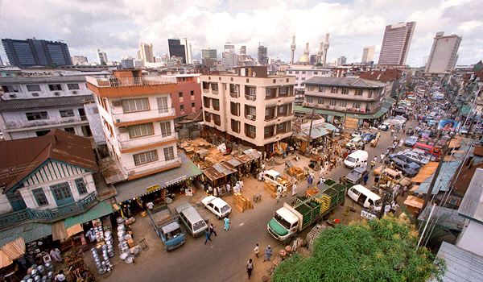

Nigeria’s Polio Immunization Program
Ahmad Adi, Angela Aherrera, Bander Alhamdan
Anna Bondy, Brian Miller, Thiri Soraiya

Slide 2

Nigeria: Geography & Landforms
Tropical rainforest climate in Southern Nigeria
118 in. of rain annually! (> 150 in. for Niger Delta)
Niger & Benu river converge & empty into the Niger Delta
Nigera Delta is a significant source of oil & natural gas

Slide 3
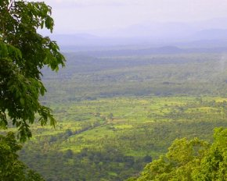
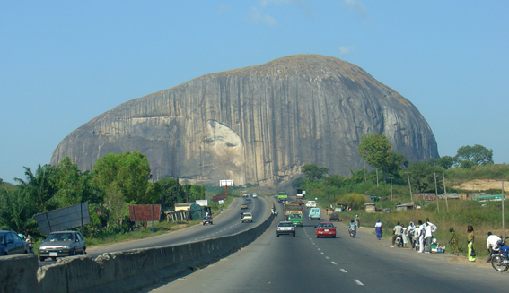
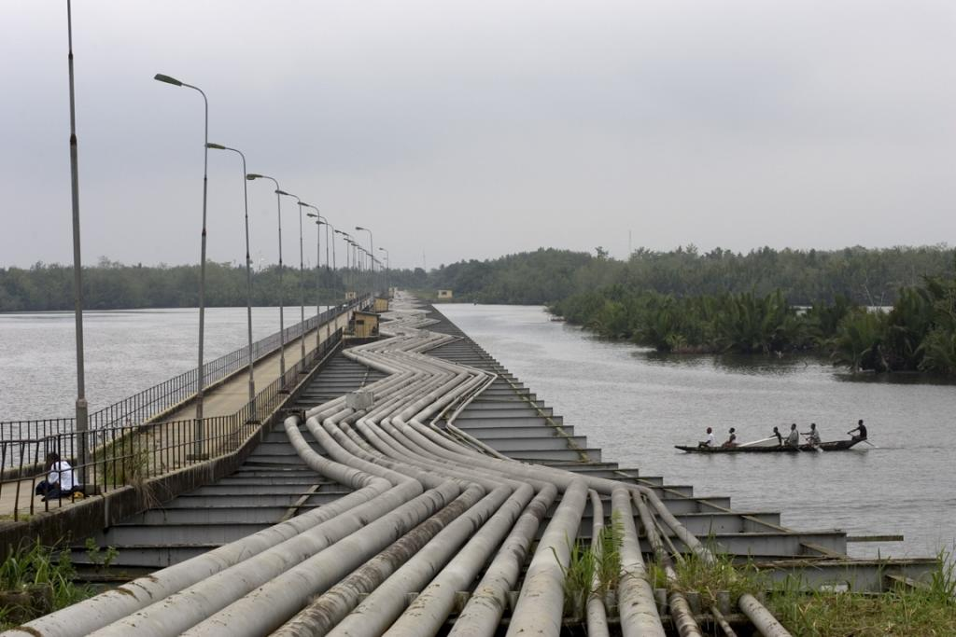
Nigeria: Geography & Landforms
View from Chappal Waddi (7,936 feet)
Zuma Rock on approach
Oil pipelines in Niger Delta

Slide 4
Background
Rain forests (primarily in the South) and savannas
Oil-rich Niger Delta served as nidus for Colony rule and later source of strife and military rule
Free elections first held in 1999
Current economy: rapid growth, high inflation
  Industry: Crude oil, coal, tin, columbite, palm oil, peanuts, cotton, rubber, wood, hides and skins, textiles
  Agriculture: Cacao, peanuts, palm oil, corn; cattle; timber; fish
  Exports: Petroleum and petroleum products, cacao, rubber

Slide 5
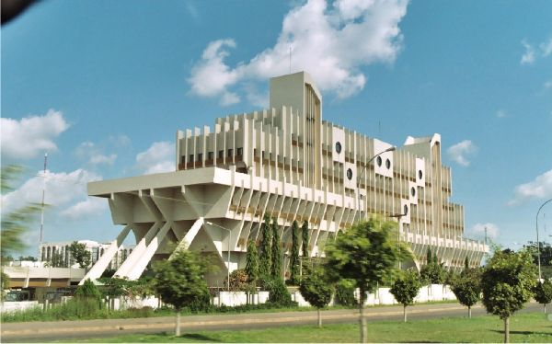
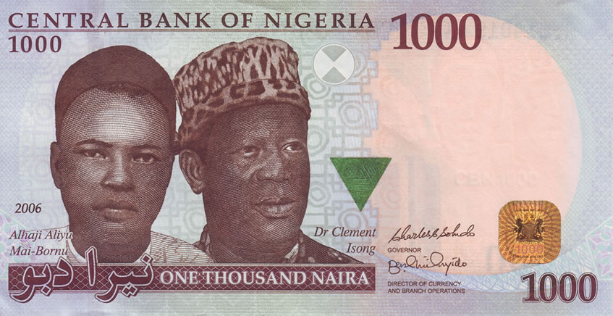
Overview: Key Country Facts
Capital: Abuja; 452,000
Area: 923,768 square kilometers (356,669 square miles)
Language: English, Hausa, Yoruba, Igbo, Fulani
Religion: Muslim, Christian, indigenous beliefs
Currency: Naira
Notes:
http://flagpedia.net/data/currency/ngn/one-thousand-naira.jpg
http://www.nairaland.com/8874/abuja-skyline-day-night-time

Slide 6
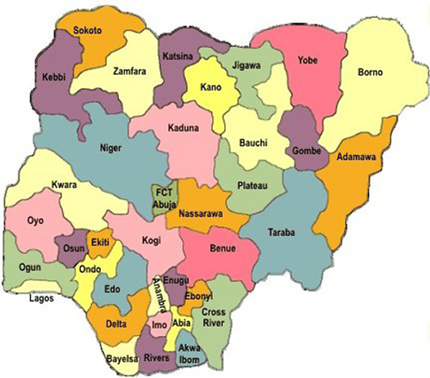
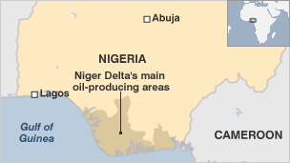
Overview: Key Country Facts
GDP per Capita: U.S. $900 (26th in world)
Literacy Percent: 68%
Politics: 36 states & 1 Federal Territory
Trade: US is largest trading partner (40% of crude oil exports)
Notes:
http://www.nairaland.com/887560/need-new-states-nigeria

Slide 7
Economic Background
Gross national income per capita (PPP international $, 2012) | 2,450
Life expectancy at birth m/f (years, 2012) | 53/55
Probability of dying under five (per 1 000 live births, 2012) | 124
Probability of dying between 15 and 60 years m/f (per 1 000 population, 2012) | 371/346
Total expenditure on health per capita (Intl $, 2012) | 161
Total expenditure on health as % of GDP (2012) | 6.1
Latest data available from the Global Health Observatory
Source: http://www.who.int/countries/nga/en/

Slide 8
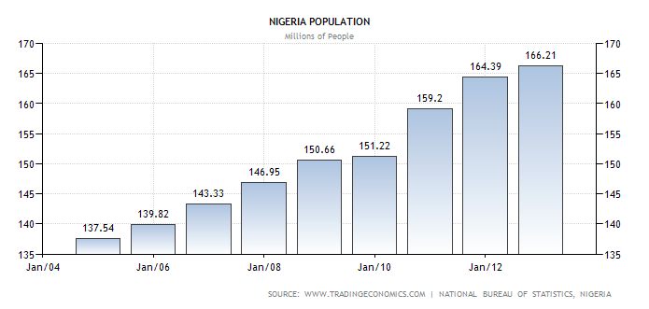
Population Trends
2012 Population: 166.2 Million
Current Estimated Population: 178.6 Million
Source: http://www.tradingeconomics.com/nigeria/population

Slide 9
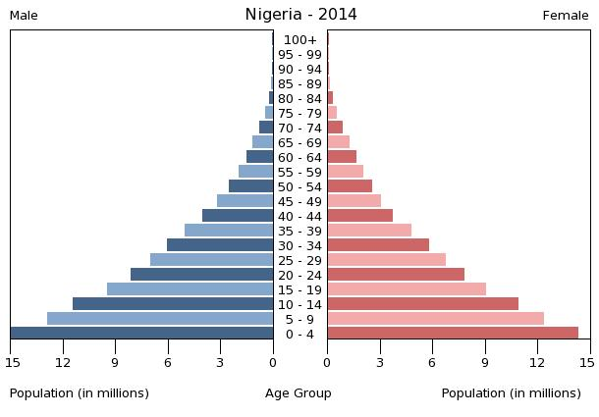
Population Pyramid 2014
Young Age Structure
Median Age: 19 years old
Source: http://econ398.academic.wlu.edu/2014/02/nigerian-fertility-rate-and-issues/

Slide 10
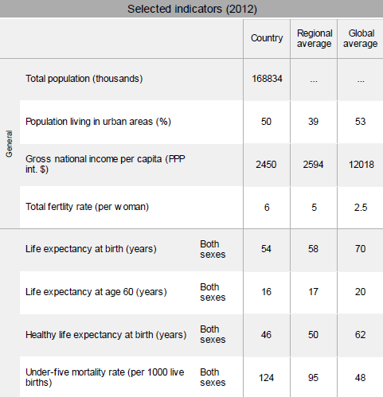
High Fertility Rate
Source: http://www.who.int/gho/countries/nga.pdf?ua=1

Slide 11
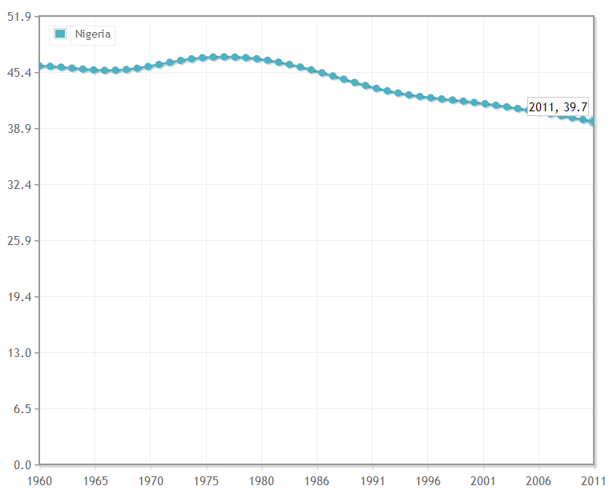
Crude Birth Rate (per 1,000 people)
Trends in Births & Death
Source: http://www.indexmundi.com/facts/indicators/SP.DYN.CBRT.IN/compare?country=ng

Slide 12
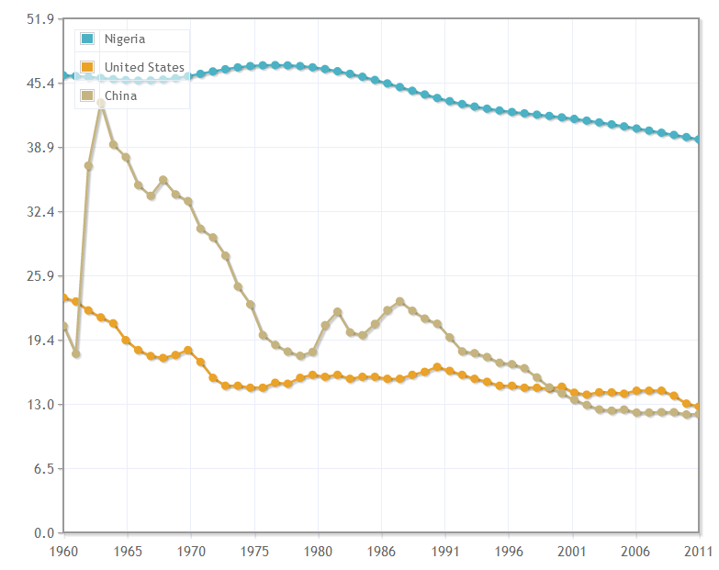
Comparing Crude Birth Rates:
US, China, & Nigeria
Trends in Births & Death
Source: http://www.indexmundi.com/facts/indicators/SP.DYN.CBRT.IN/compare?country=ng#country=cn:ng:us

Slide 13
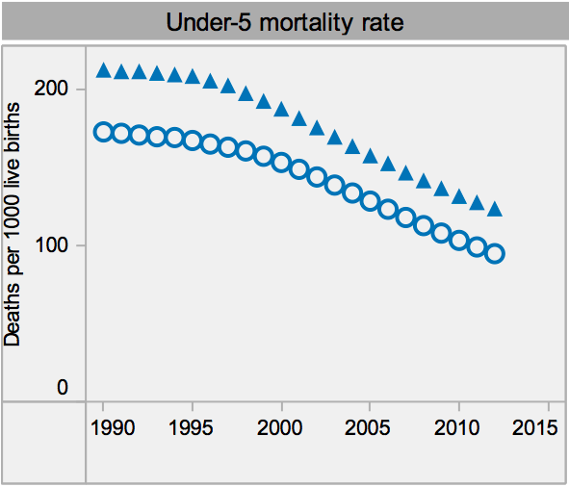
Trends in Births & Death
Declining Mortality Under Age 5
Source: http://www.who.int/gho/countries/nga.pdf?ua=1

Slide 14
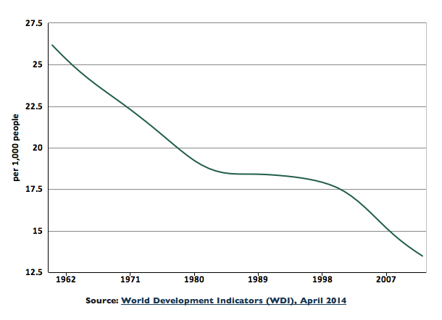
Trends in Births & Death
Declining Mortality: Crude Death Rate
Crude Death Rate: 13.5%
Source: http://knoema.com/atlas/Nigeria/Death-rate

Slide 15
Rapid Growth!
Overall Nigerian Population Trends
Annual Population Growth Rate: 2.24%
Population changed by 268% in the half-century
  45.2 Million in 1960 to 166.2 Million in 2012
Nigeria population makes 2.35% of worlds total population
  1 person in every 43 people is from Nigeria

Slide 16
Overall Nigerian Population Trends
Projected Population:
240 Million people in 2025
Source: http://www.africapedia.com/NIGERIA:-POPULATION-TRENDS

Slide 17
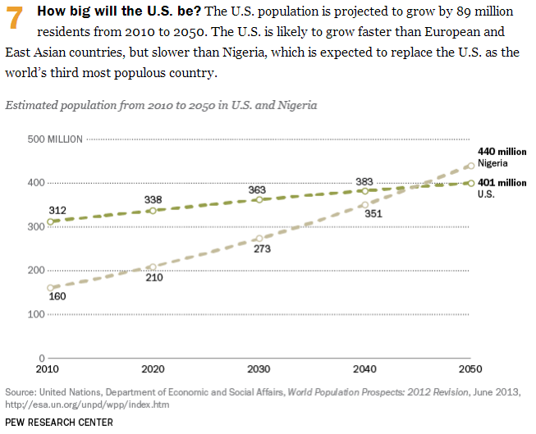
Projected Growth: U.S. versus Nigeria
Notes:
Source: http://www.pewresearch.org/fact-tank/2014/02/03/10-projections-for-the-global-population-in-2050/

Slide 18
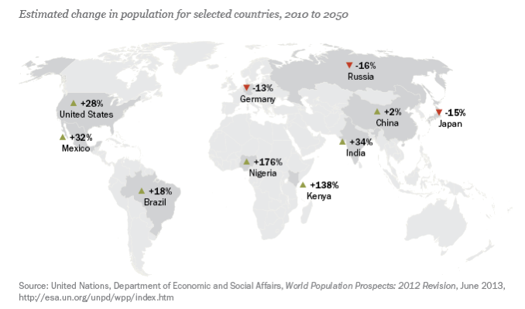
Projected Growth: Biggest changes in 2050

Slide 19
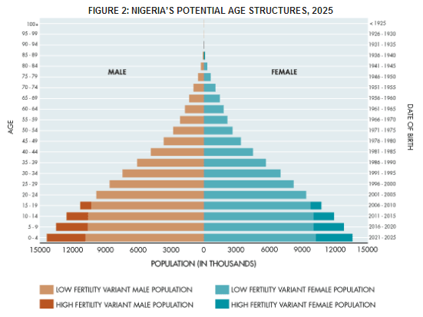
Projected Population Pyramid 2025
The low fertility scenario is based on 3 children/woman
The high fertility is based on 4 children/woman
Source: http://populationaction.org/reports/demographic-development-reversing-course/

Slide 20
Summary: Trends
Nigeria has a classic pyramid shape indicating a very young population
It is experiencing rapid population growth due to demographic transition with a high fertility rate and a declining mortality rate
With a 2.4% Population growth rate, it is projected to surpass the U.S. population and rank 3rd most population in 2050
Notes:
. In both of the years shown, Nigeria’s population maintains the classic pyramid shape of a very youthful population, with progressively larger proportions among each successively younger age group.

Slide 21
Polio: A Morbid Disease
Demographics
Primarily affects children < 5 years of age
1/200 infections --> irreversible paralysis
  Of these, 5 – 10 % die due to respiratory failure
Highly contagious virus spread via fecal-oral route
One case can trigger thousands more
Source: http://www.who.int/mediacentre/factsheets/fs114/en/

Slide 22
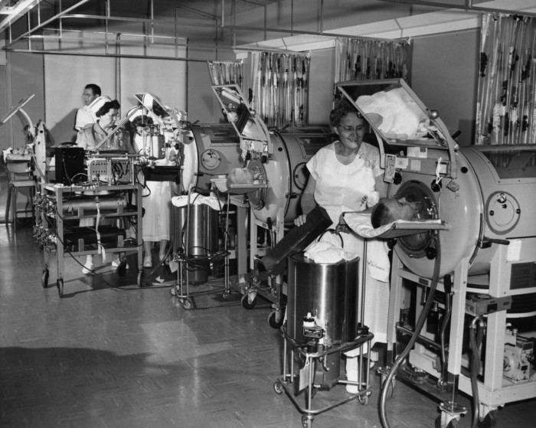
Polio: A Morbid Disease
Negative-pressure ventilators: the “Iron Lung”

Slide 23
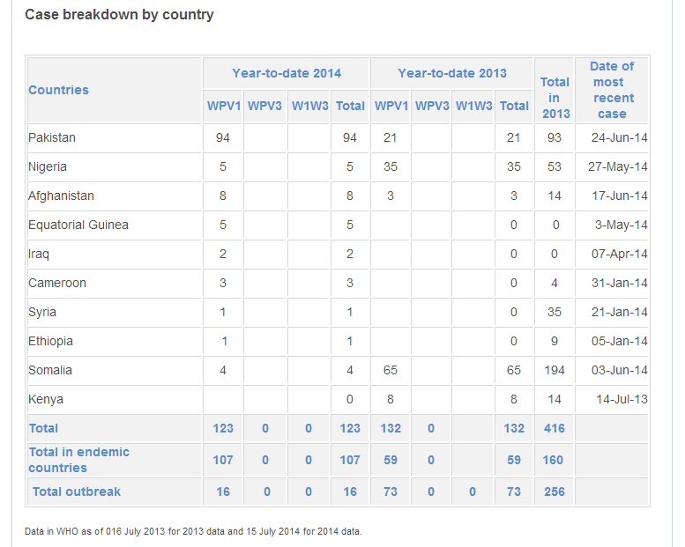
Polio: Case Breakdown
Source: http://www.polioeradication.org/dataandmonitoring/poliothisweek.aspx (July 19)

Slide 24
Polio: A Morbid Disease
Symptoms
Fever, fatigue, headache, vomiting, stiffness and pain in neck & limbs
Diagnosis
Symptoms and suspicion of disease (Developing World)
Antibodies or PCR of stool, saliva, etc (Developed World)
Treatment
None – only supportive treatment available
Immunization is key
Source: http://www.who.int/mediacentre/factsheets/fs114/en/

Slide 25
Polio Vaccination Rates
Vaccination rate amongst 1 year-olds (%)
Country | 2000 | 2001 | 2002 | 2003 | 2004 | 2005 | 2006 | 2007 | 2008 | 2009 | 2010 | 2011 | 2012
Niger | 41 | 42 | 43 | 44 | 45 | 46 | 52 | 57 | 68 | 71 | 75 | 44 | 78
Nigeria | 31 | 36 | 40 | 42 | 43 | 45 | 46 | 54 | 60 | 66 | 54 | 56 | 59
India | 59 | 58 | 57 | 59 | 61 | 55 | 68 | 66 | 70 | 70 | 70 | 70 | 70
USA | 90 | 89 | 90 | 91 | 92 | 92 | 93 | 93 | 94 | 93 | 93 | 93 | 93
% of 1 year-olds who received 3 doses of polio vaccine within one year
Source: http://apps.who.int/gho/data/node.main.A831?lang=en

Slide 26
Polio: A Morbid Disease
Vaccination program: assumptions
$1.00 per dose for urban v. $1.50 per dose for rural delivery
4 doses needed in 1 year with 10% wastage (or 4.1 doses per birth)
Initial urban – rural split is 50%
  Fraction of urban births increases at a rate of 7.5% of base rate annually (shift in agricultural to industrial production)
Source: Concepcion, F.E., et al. “Poliovirus vaccination options for achieving eradication and securing the endgame.” Current Opinion in Virology 2013:3(3):309-315

Slide 27
Polio: A Morbid Disease
Vaccination program: assumptions
Initial population is 168,834,000 in 2012
Crude birth rate 39.7 in 2012
Target vaccination rate 85% (herd immunity)
Take-up of immunization is 95%
Source: Concepcion, F.E., et al. “Poliovirus vaccination options for achieving eradication and securing the endgame.” Current Opinion in Virology 2013:3(3):309-315

Slide 28
Polio: A Morbid Disease
Vaccination program: cost of vaccinating new births
Calendar Year | Urban delivery cost (USD) | Rural delivery cost (USD) | Delivery cost (USD)
2015 | $11,078,325 | $15,638,856 | $26,717,182
2016 | $10,857,822 | $15,092,238 | $25,950,060
2017 | $10,641,708 | $14,562,901 | $25,204,610
2018 | $10,429,896 | $14,050,328 | $24,480,223
2019 | $10,222,299 | $13,554,014 | $23,776,313
2020 | $10,018,834 | $13,073,472 | $23,092,306
2021 | $9,819,419 | $12,608,227 | $22,427,647
2022 | $9,623,974 | $12,157,820 | $21,781,794
2023 | $9,432,418 | $11,721,802 | $21,154,220
2024 | $9,244,675 | $11,299,741 | $20,544,416
2025 | $9,060,669 | $10,891,214 | $19,951,884

Slide 29
Polio: A Morbid Disease
Vaccination program: Additional Cost of Current Need (2025)
Unmet vaccination need (# of doses) | Urban delivery cost (USD) | Rural delivery cost (USD) | Delivery cost (USD)
10,098,947 | $5,125,500 | $7,460,171 | $12,585,671

Slide 30
Polio: A Morbid Disease
Delivery & monitoring system
School campaigns with government mandate
Public advertising
Trained lay people or village council members for rural areas
Urban trained lay health workers
Cell-phone based survey and reporting systems for rural and urban areas
Central repository for data collection and monitoring

Slide 31
Summary & Conclusions
Nigeria is experiencing a rapid growth rate (2.4%), and it is projected that by 2050 the population of Nigeria will surpass the population of the US.
There is an increased demand on childhood vaccinations with this rapid growth, including polio.
Polio vaccination is projected to cost around 25M$ at 2025 for new born infants that year
How to implement such a program?

Slide 32
Thank You
Ahmad Adi, Angela Aherrera, Bander Alhamdan
Anna Bondy, Brian Miller, Thiri Soraiya

Slide 33
Appendix i: References
http://www.worldatlas.com/webimage/countrys/africa/ng.htm
National Geographic Atlas of the World, Eighth Edition, http://travel.nationalgeographic.com/travel/countries/nigeria-facts/
http://www.who.int/countries/nga/en/
http://www.tradingeconomics.com/nigeria/population
http://econ398.academic.wlu.edu/2014/02/nigerian-fertility-rate-and-issues/
http://www.who.int/gho/countries/nga.pdf?ua=1
http://www.indexmundi.com/facts/indicators/SP.DYN.CBRT.IN/compare?country=ng
http://www.who.int/gho/countries/nga.pdf?ua=
http://knoema.com/atlas/Nigeria/Death-rate
http://www.africapedia.com/NIGERIA:-POPULATION-TRENDS
http://www.pewresearch.org/fact-tank/2014/02/03/10-projections-for-the-global-population-in-2050/
http://populationaction.org/reports/demographic-development-reversing-course/
Concepcion, F.E., et al. “Poliovirus vaccination options for achieving eradication and securing the endgame.” Current Opinion in Virology 2013:3(3):309-315

Slide 34
Appendix ii: Cost Computation Table
Cost computation table
Calendar Year | Total Population (in 000s) | Crude Birth rate (per 1,000) | Total doses needed | Urban Births fraction | Rural Births fraction | Urban delivery cost (USD) | Rural delivery cost (USD) | Delivery cost (USD)
2011 | 164,877 | 39.7 | 24,012,072 | 50.0% | 50.0% | $12,006,036 | $18,009,054 | $30,015,090
2012 | 168,834 | 37.7 | 23,358,944 | 50.4% | 49.6% | $11,767,068 | $17,387,814 | $29,154,882
2013 | 172,886 | 35.8 | 22,723,580 | 50.8% | 49.2% | $11,532,856 | $16,786,086 | $28,318,943
2014 | 177,035 | 34.0 | 22,105,499 | 51.1% | 48.9% | $11,303,306 | $16,203,289 | $27,506,595
2015 | 181,284 | 32.3 | 21,504,229 | 51.5% | 48.5% | $11,078,325 | $15,638,856 | $26,717,182
2016 | 185,635 | 30.7 | 20,919,314 | 51.9% | 48.1% | $10,857,822 | $15,092,238 | $25,950,060
2017 | 190,090 | 29.2 | 20,350,309 | 52.3% | 47.7% | $10,641,708 | $14,562,901 | $25,204,610
2018 | 194,652 | 27.7 | 19,796,781 | 52.7% | 47.3% | $10,429,896 | $14,050,328 | $24,480,223
2019 | 199,324 | 26.3 | 19,258,308 | 53.1% | 46.9% | $10,222,299 | $13,554,014 | $23,776,313
2020 | 204,108 | 25.0 | 18,734,482 | 53.5% | 46.5% | $10,018,834 | $13,073,472 | $23,092,306
2021 | 209,006 | 23.8 | 18,224,904 | 53.9% | 46.1% | $9,819,419 | $12,608,227 | $22,427,647
2022 | 214,023 | 22.6 | 17,729,187 | 54.3% | 45.7% | $9,623,974 | $12,157,820 | $21,781,794
2023 | 219,159 | 21.5 | 17,246,953 | 54.7% | 45.3% | $9,432,418 | $11,721,802 | $21,154,220
2024 | 224,419 | 20.4 | 16,777,836 | 55.1% | 44.9% | $9,244,675 | $11,299,741 | $20,544,416
2025 | 229,805 | 19.4 | 16,321,479 | 55.5% | 44.5% | $9,060,669 | $10,891,214 | $19,951,884

