Slide 1

Increasing Fruit and Vegetable Intake Among School-Age Children Through the Use of Taste Testing and Role-Playing Games
Emily Rice, Dietetic Intern
Anna Bondy, Dietetic Intern
University of Maryland Medical Center
Food Supplement Nutrition Education (FSNE)

Slide 2

Objectives
To decrease food neophobia in children
To increase the consumption of fruits and vegetables among children

Slide 3
Background
An estimated 17% of children and adolescents ages 2 to 19 are at or above the 95th percentile for BMI and 31.7% are at or above the 85th percentile ⁽¹⁾
For children 6 to 11 years old 74.1%-83.8% are not meeting fruit and vegetable intake recommendations ⁽²⁾
Pre-school-aged children consumed on average 80% of the recommended fruit serving/day and only 25% of the recommended vegetable servings/day ⁽³⁾
Low fruit and vegetable intake is associated with inadequate intake of vitamin A, vitamin C, and fiber and higher intakes of total fat and saturated fat ⁽³⁾
Many eating patterns and food preferences are maintained from childhood into adulthood ⁽⁴⁾

Slide 4
Theory
An emotionally positive atmosphere combined with repeat exposures can break down resistance to new foods ⁽⁵⁾
Children imitate other adults and will try new foods they see parents eating ⁽⁶⁾
Nursery school age children will imitate eating habits and preferences of other children ⁽⁷⁾
Children given repeated exposures to an unfamiliar vegetable were more likely to increase consumption compared to a control group and a reward-based group ⁽⁸⁾

Slide 5
Program Details
The independently available lesson, “Music & Movement: Nutrition in Action” developed by Jenny Steinhaus, M.S., L.N. encourages fruit and vegetable intake and teaching children about farmer’s markets
The FSNE program aims to educate on healthy food choices
As part of the effort to reduce children’s fear of trying new foods, certain rules are laid out in advance of the food-tasting:
  The children are not allowed to say negative things about the food, like “ew” or “yuck”
  If they did try a food and did not like it, they were asked to quietly and discretely spit it into their napkin
  They are also asked to try each food at least once

Slide 6

Program Components
Figure 1: “A Day at the Market” by Sara Anderson
During our experience with FSNE, we observed and later participated in the Music & Movement program
During the story, “A Day at the Market” by Sara Anderson, the children were asked to identify different fruits and vegetables in the story
Part 1

Slide 7
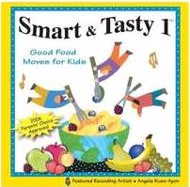
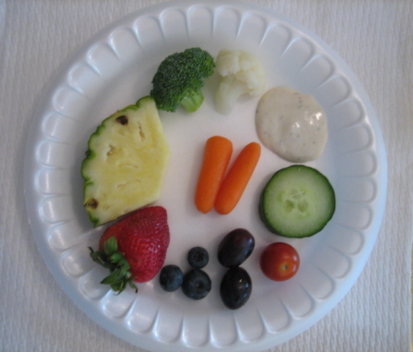
The song, “Farmer’s Market”, was part of a game where the children placed their fruit or vegetable in a shopping bag as it was being named
Part 2
Figure 3: Farmer’s Market Sample Plate
Figure 2: Smart & Tasty 1 CD cover
The final part of the lesson was a “Farmer’s Market Party” where we offered the students cauliflower, broccoli, grape tomatoes, baby carrots, cucumber, pineapple, grapes, strawberries, and blueberries
Part 3

Slide 8
Effective Strategies for Fighting Food Aversion
Students were given positive reinforcement. They were told they did a good job trying new foods
Children were encouraged to dip leftover vegetables in ranch dressing to make them more palatable
Any children that refused to try a fruit/vegetable were never forced to eat anything
Children were encouraged to tell their parent or caregiver about what they had learned and the new produce they liked

Slide 9

Lessons Learned
Children in schools not served by FNSE would benefit from a program that includes exposure to produce
Older children would benefit from being exposed to new produce
Continuing education into older years and introducing new foods each year would be beneficial in expanding children's diets and increasing the acceptability of fruits and vegetables
This program would be beneficial in
additional settings, including day care
and summer camps

Slide 10
Evaluation
There is currently no evaluation for this program
A questionnaire could be used to gauge attitudes towards produce
A worksheet could be given to the children before and after the program to assess whether tasting the produce changed preferences
In the future, obtaining this information would be beneficial in understanding the impact this program has on reducing food neophobia

Slide 11
Our Experience
Both the story and the game focused on creating a positive environment and building excitement over trying new fruits and vegetables
Students encouraged each other to try their favorite foods and asked for more vegetables when they saw their peers receiving more
In order to encourage the children to try all the foods on their plate:
  All the adults sat with the children
  The adults discussed fruits and vegetables they enjoy
  Verbal reinforcement was given to encourage intake
  Children were offered more of the foods they did enjoy
  We discussed eating these foods at home

Slide 12
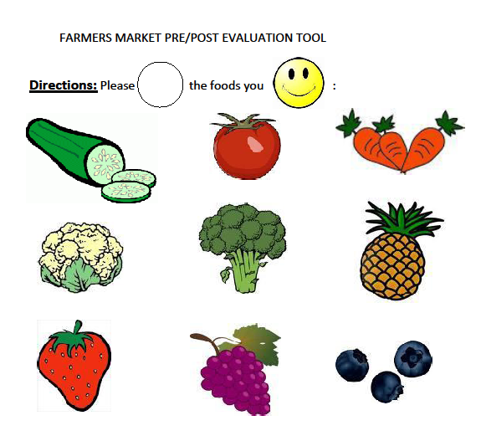
Figure 4: Sample evaluation
Changes in responses can be used to gauge whether children are more accepting of the produce

Slide 13
Conclusion
This program incorporates exposure and adult/peer role modeling to decrease food neophobia and increase fruit and vegetable acceptability and consumption
The use of positive atmosphere and reinforcement during food exposure increases the likelihood that children will participate and view the experience favorably
This decreases the neophobic response and increases the likelihood that children will continue to try and accept new produce

Slide 14
References
1) Irigoyen M, Glassman M, Chen S, Findley S. Early Onset of Overweight and Obesity among Low-Income 1-to 5-Year Olds in New York City. Journal of Urban Health. 2008; 85 (4): 545-554.
2) Bai Y, Feldman C, Wunderlich S, Aletras S. Process Evaluation of the Fresh Fruit and Vegetable Program Implementation in a New Jersey Elementary School. School nutrition association. 2011; 35 (2).
3) Dennison B, Rockwell H, Baker S. Fruit and Vegetable Intake in Young Children. Journal of the American College of Nutrition. 1998; 17 (4): 371-378
4) Perry C, Bishop D, Taylor G, Davis M, Story M, Gray C, Bishop C, Warren Mays R, Lytle L, Harnack L. A Randomized School Trial of Environmental Strategies to Encourage Fruit and Vegetable Consumption among Children. Health Education & Behavior. 2004; 31(1): 65-76.
5) Benton D. Role of parents in the determination of the food preferences of children and the development of obesity. International Journal of Obesity. 2004; 28: 858-869.
6) Harper L, Sanders K. The Effect of Adults’ eating on young children’s acceptance of unfamiliar foods. Journal of Experimental Child Psychology. 1975; 20 (2): 206-214
7) Birch L. Preschool Children’s Food Preferences and Consumption Patterns. Journal of Nutrition Education. 1979; 11(4): 189-192.
8) Wardle J., Herrera M-L., Cooke L., Gibson E. Modifying children’s food preferences: the effects of exposure and reward on acceptance of an unfamiliar vegetable. European Journal of Clinical Nutrition. 2003; 57: 341-348.

Slide 15
Funding Disclosure
Funding for the SNAP-Ed program is provided by USDA in cooperation with the Maryland Department of Human Resources and the University of Maryland Extension

Slide 16
Contact Information
Emily Rice: erice@umm.edu
Anna Bondy: abondy@umm.edu

