Slide 1
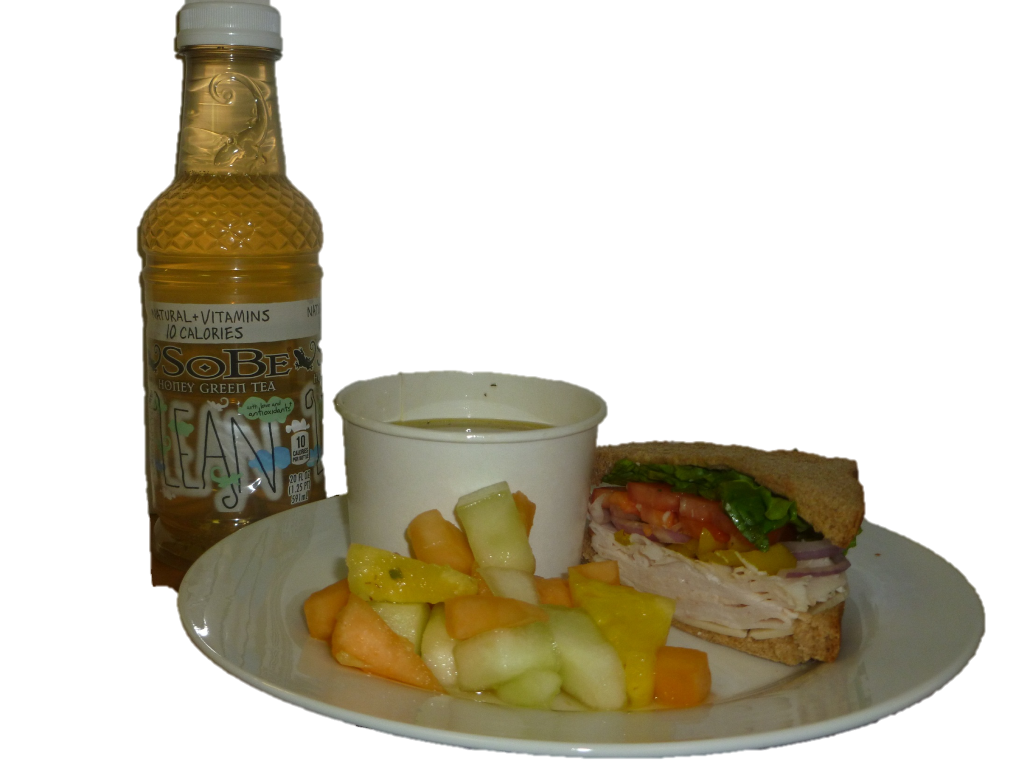
Sandwich Station
MAKE IT HEALTHY!
½ Turkey Sandwich, Small Chicken Noodle Soup, ½ Fruit Cup, & Diet Iced Tea
Estimated 450 calories, 9 g fat, 28 g protein

Slide 2
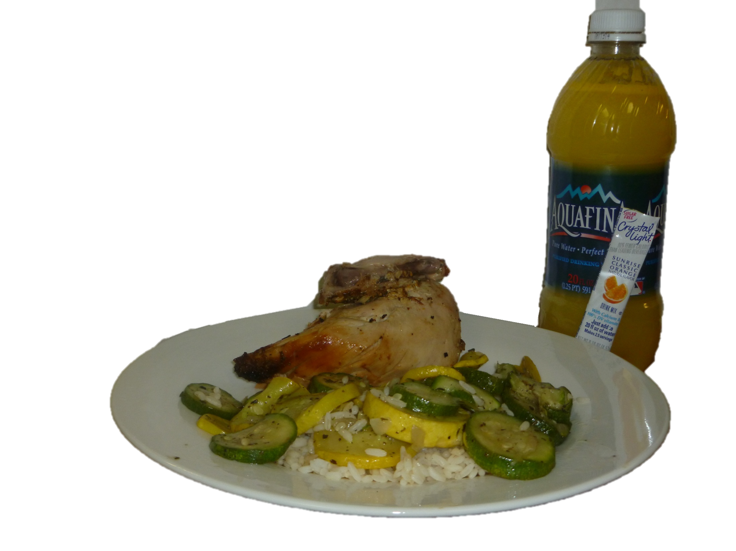
Home Station
MAKE IT HEALTHY!
Skinless Chicken Breast with Wing, ½ cup white rice, Summer Squash & Crystal Light
Estimated 285 calories, 6 g fat, 27 g protein

Slide 3
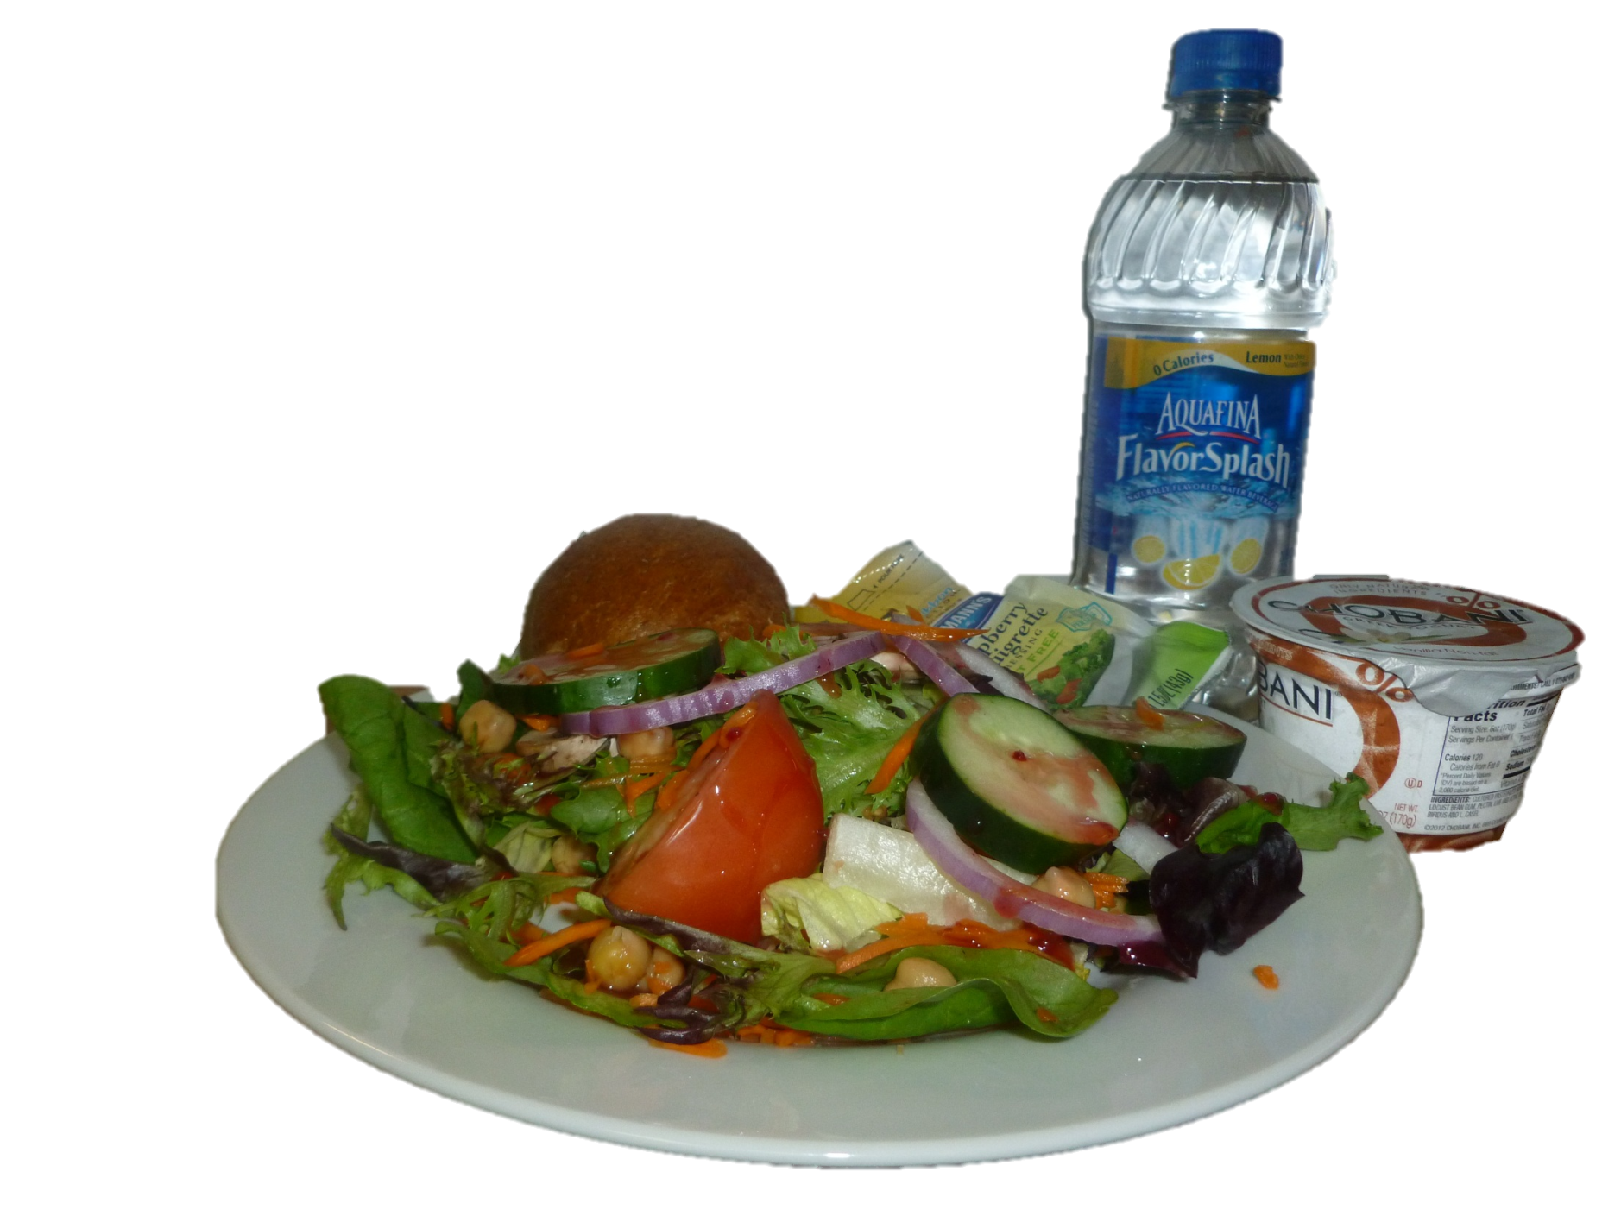
Salad Bar
MAKE IT HEALTHY!
Garden Salad, Light Vinaigrette, Fat Free
Chobani, Wheat Roll, Flavored Water
Estimated 400 calories, 8 g fat, 26 g protein

Slide 4
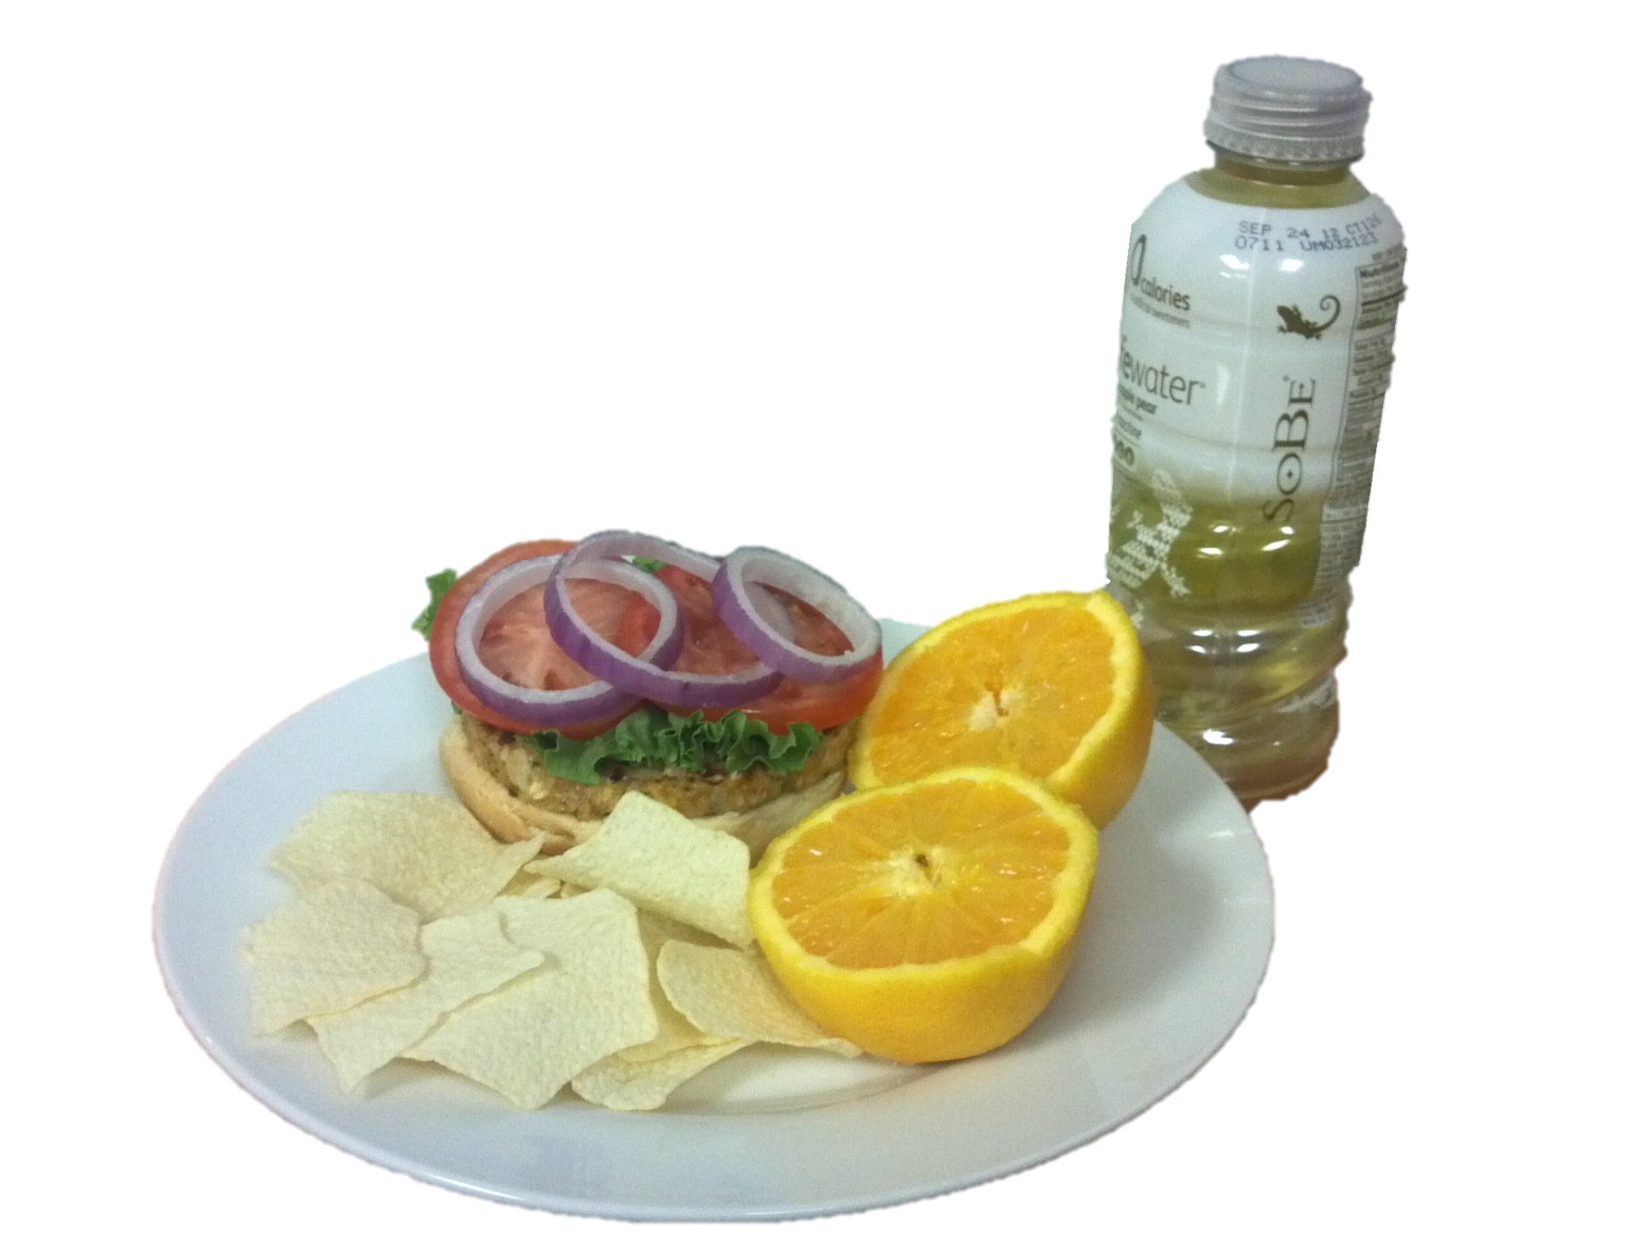
Grill
MAKE IT HEALTHY!
Veggie Burger on ½ Roll with Lettuce, Tomato, & Onion ½ oz Baked Chips, and Orange
Estimated 410 calories, 9 g fat, 22 g protein

